Slide 1
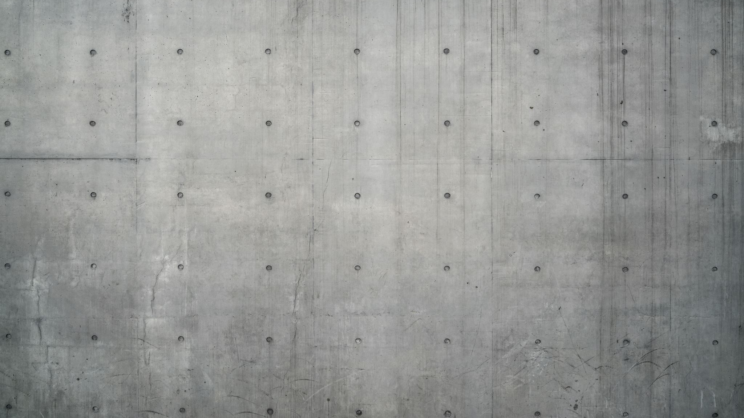
ASCRS Grand Rounds
Kevin Miller, MD
Jae Kim, MD
UCLA Stein Eye Institute

Slide 2
Financial Disclosure
Dr. Miller
  None
Dr.Kim
  None

Slide 3
CC/HPI
36 y.o. woman
  referred from the outside provider
CC: “I cannot see in my left eye and the light bothers me”
HPI:
  Trauma in the left eye 2 years ago.
ROS:
  Negative.

Slide 4
Histories
PMH:
  None
POH:
  Implantable Collamer Lens (ICL) – Both Eyes 2 years ago before the trauma
Medication:
  None
Family and Social History:
  Noncontributory

Slide 5
Exam
 | OD | OS
Visual Acuity | 20/20 | HM
Pupils | Round and reactive | Photo
Intraocular Pressure | 14 | 16
Extraocular movements | Full | Full
Confrontational VF | Full | Full

Slide 6
Exam
 | OD | OS
Anterior Exam | WNL | Photo
Posterior Exam | WNL | WNL

Slide 7
Anterior Exam

Slide 8
Anterior Exam

Slide 9
Anterior Exam

Slide 10
Anterior Exam

Slide 11
Anterior Exam
Iris/ICL Expulsion
Main
Wound

Slide 12
Assessment
Traumatic Aniridia
Traumatic Cataract

Slide 13
Panel Discussion
For traumatic Aniridia and Cataract
  Evaluation Process
    Key exam findings and/or Diagnostic test
  Surgical options
    Expect Unexpected ?

Slide 14
Our Patient

Slide 15
Management
Combined
Cataract Surgery
Prosthetic Iris
  CustomFlex from HumanOptics
Front
Back

Slide 16
Management
Combined
Cataract Surgery
Prosthetic Iris
  CustomFlex from HumanOptics
Front
Back
Patient: ”Other than the Iris and Cataract,
are there any other conditions that can develop in my left eye in the future?”

Slide 17
Panel Discussion
Learning how to implant the prosthetic Iris
  For young ophthalmologists, which resource?
  Good vs Poor patient candidates
In addition to Aniridia and Cataracts,
  Any short and long term ophthalmic concerns after trauma

Slide 18
Back to our pt.
VA: 20/25 OS doing well.

Slide 19
Thank you
Dr.Kevin Miller

Slide 20
Panel Discussion
Complications
  Associated with prosthetic iris

