Slide 1
Navigating Presbyopia Correction in Mild Ectasia with High Expectations
Catherine Sheils, MD
Resident Physician, PGY-3

Slide 2
Disclosures
No relevant financial disclosures

Slide 3
Case Presentation
67 y.o. F with narrow angles s/p LPI OU presents for cataract evaluation
She states she cannot watch TV, drive, read, and it is “exasperating”
She does not tolerate spectacles and states that even with glasses, she cannot see

Slide 4
Exam
 | OD | OS
Dist sc | 20/60 -2 | 20/50
Dist PH sc | 20/40 -2 | 20/30 -2
Wearing Rx | -1.00 +2.00 @018 +2.50 | -0.25 +1.25 @159 +2.50
IOP | 10 | 10
Visual Field (CF) | Full | Full
Pupil | Reactive | Reactive
APD | None | None

Slide 5
Slit Lamp Exam
 | OD | OS
Lids/lashes | Normal | Normal
Conjunctiva/sclera | White and quiet | White and quiet
Cornea | Clear | Clear
Anterior Chamber | Moderate depth | Moderate depth
Iris | Round, patent PI | Round, patent PI
Lens | 2+NS | 2+NS

Slide 6
Fundus Exam
 | OD | OS
Disc | Normal | Normal
Macula | Flat, normal foveal contour | Flat, normal foveal contour
Vessels | Normal | Normal
Gonioscopy
 | OD | OS
Gonioscopy (Shaffer) | Grade III-IV throughout | Grade III-IV throughout

Slide 7
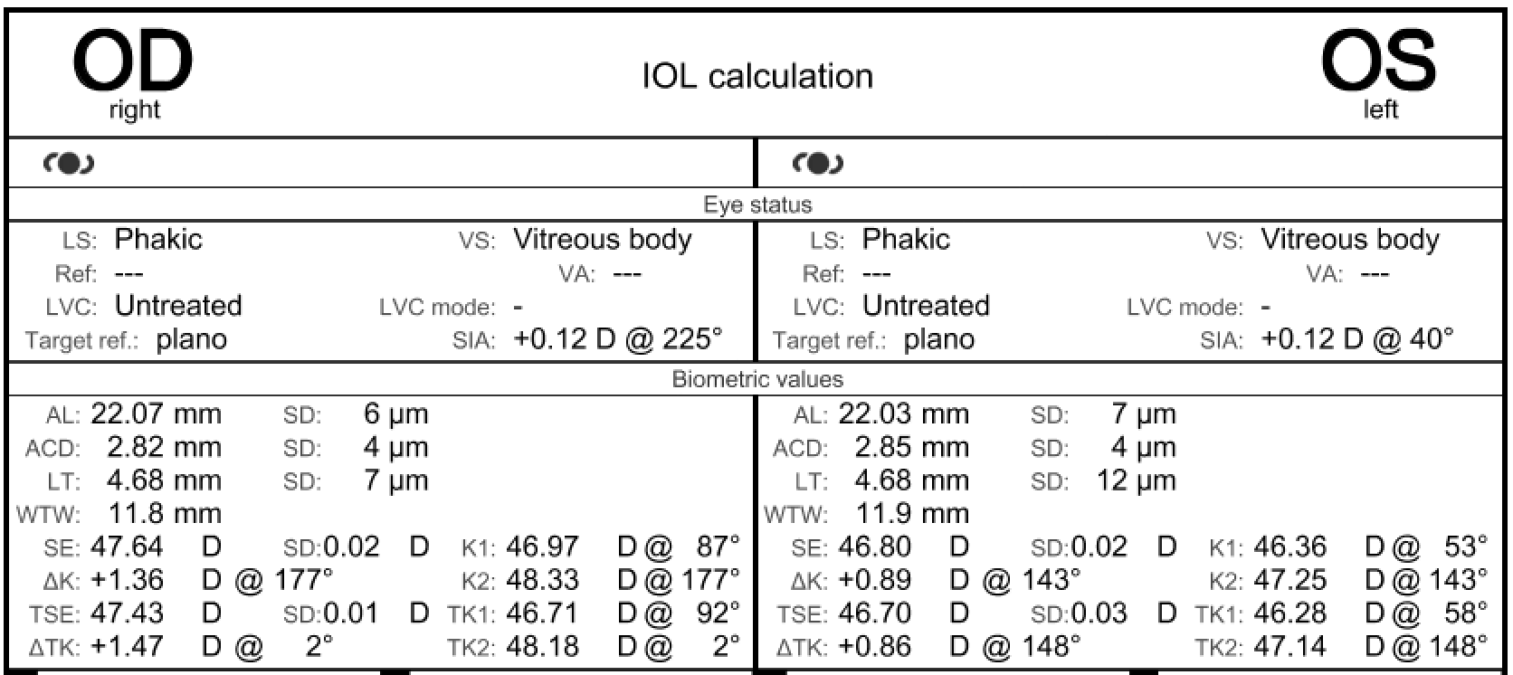
IOL Calculations

Slide 8
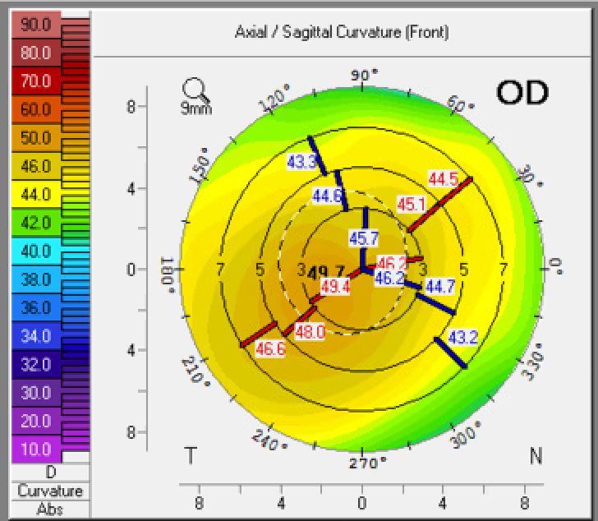
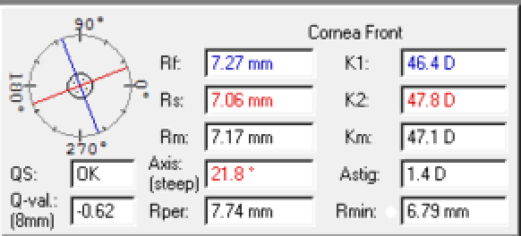
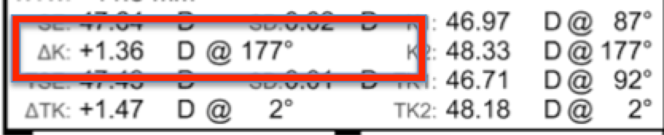
Tomography
IOLm

Slide 9
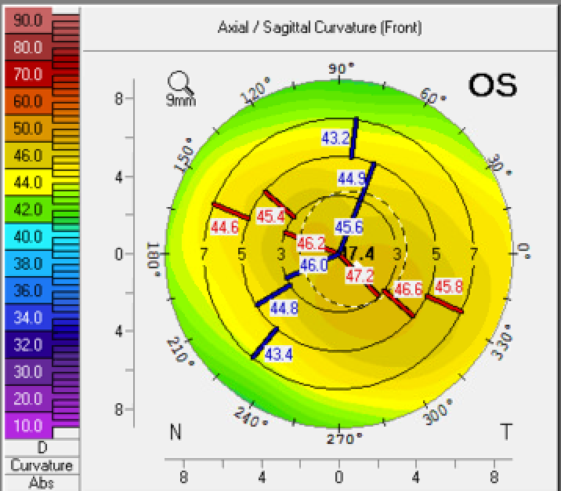
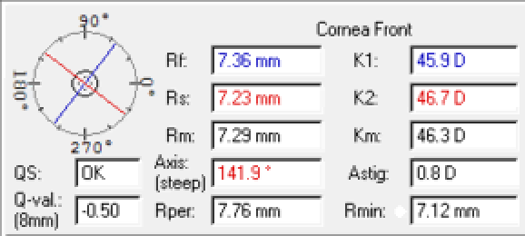
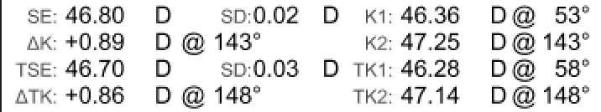
Tomography
IOLm

Slide 10
Panel Discussion
What could account for discordance between IOL master and tomography?
Would you repeat measurements?

Slide 11
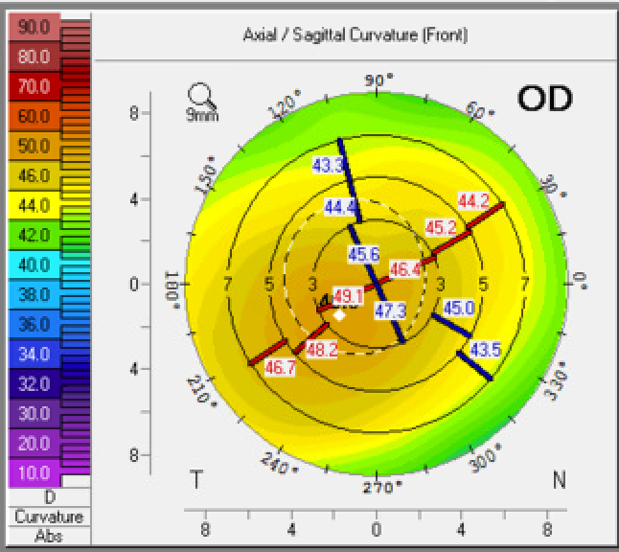
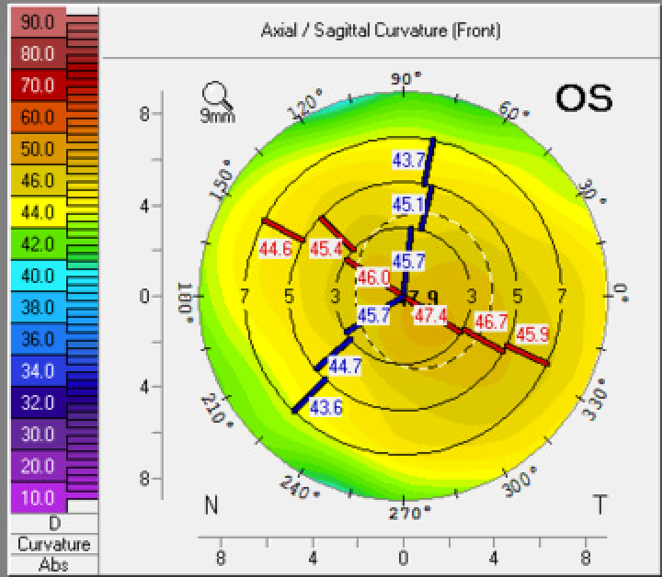
Serial Measurements
  12/11/20: 1.4 D @ 21.8
  1/15/21: 1.2 D @ 27
  2/2/21: 1.2 D @ 14.3
  3/10/21: 0.9 D @ 31
IOL master: consistent ~1.2 D @177
  12/11/20: 0.8 D @ 141.9
  1/15/21: 1.0 D @ 117.2
  2/2/21: 0.8 D @ 142.0
  IOL master: consistent ~0.9 D @143

Slide 12
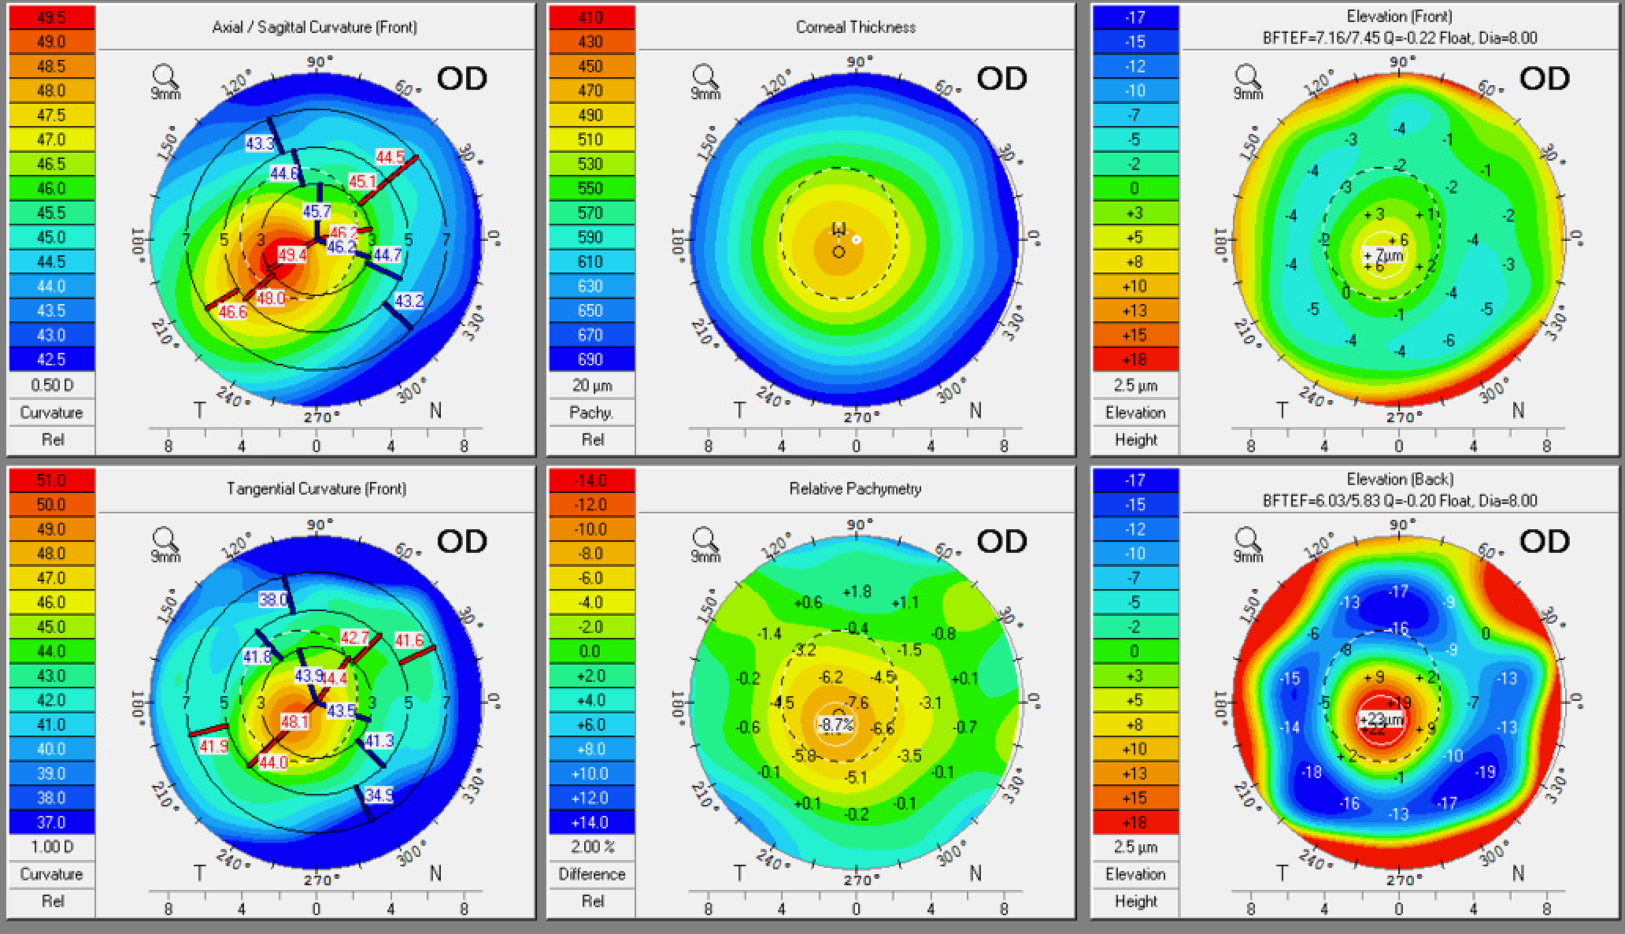
A closer look at the tomography…

Slide 13
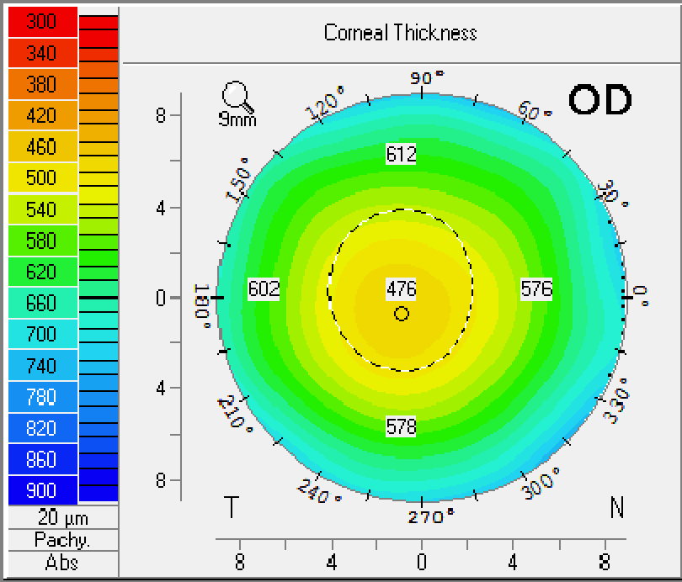
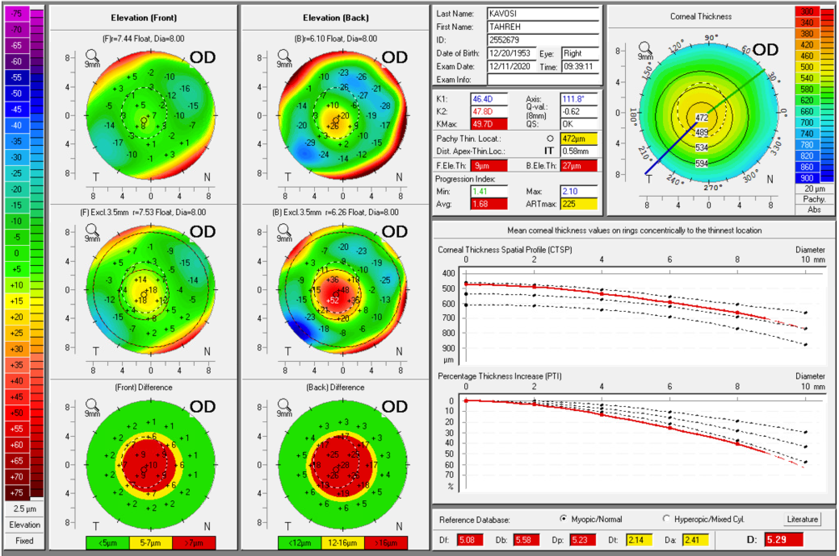

Belin Ambrosio Index
Thinnest pachy 472 um

Slide 14
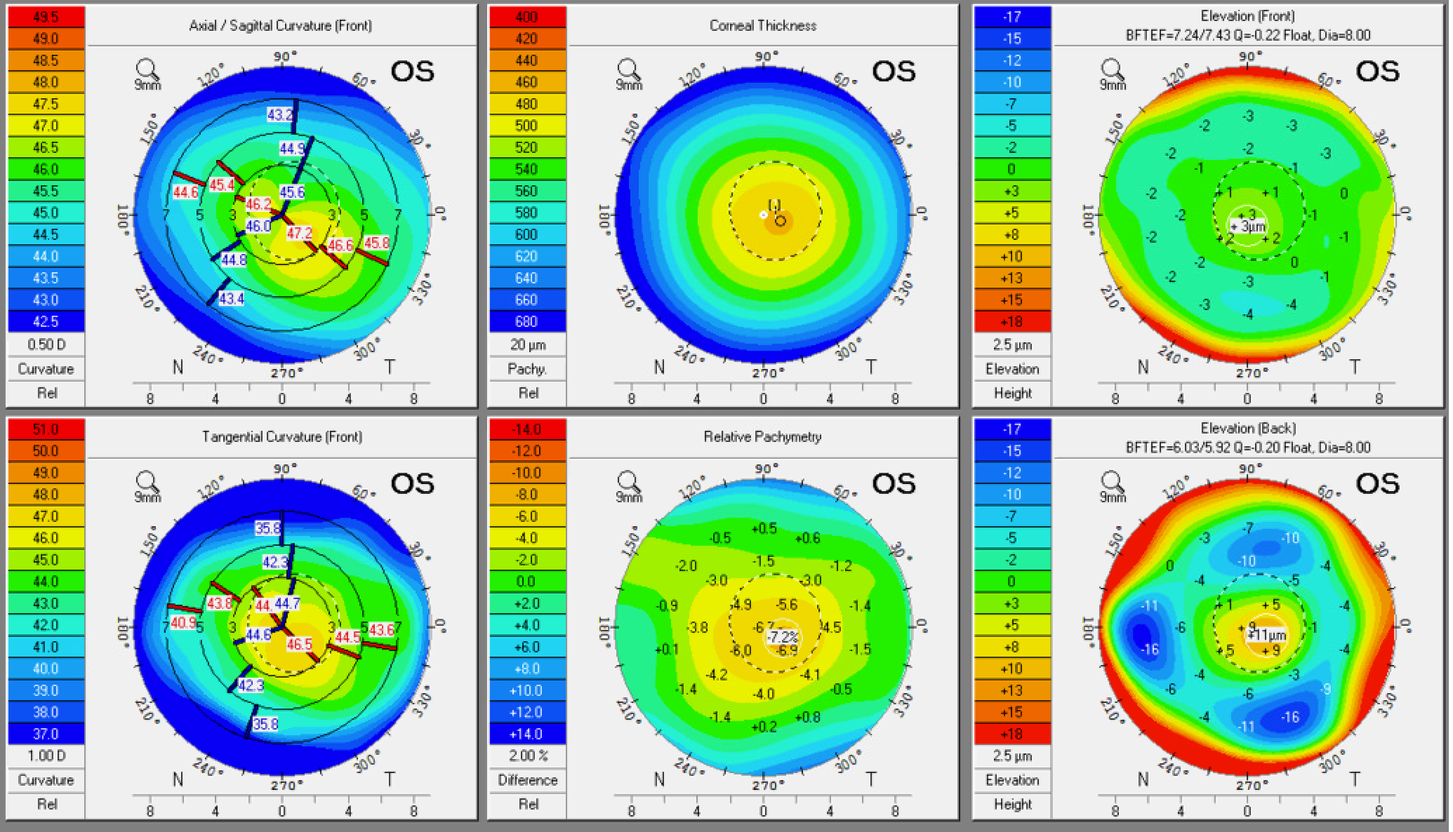
Ectasia appears milder in the left eye

Slide 15
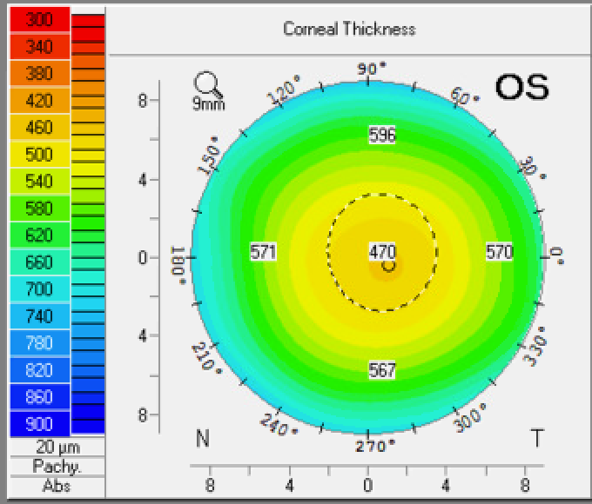
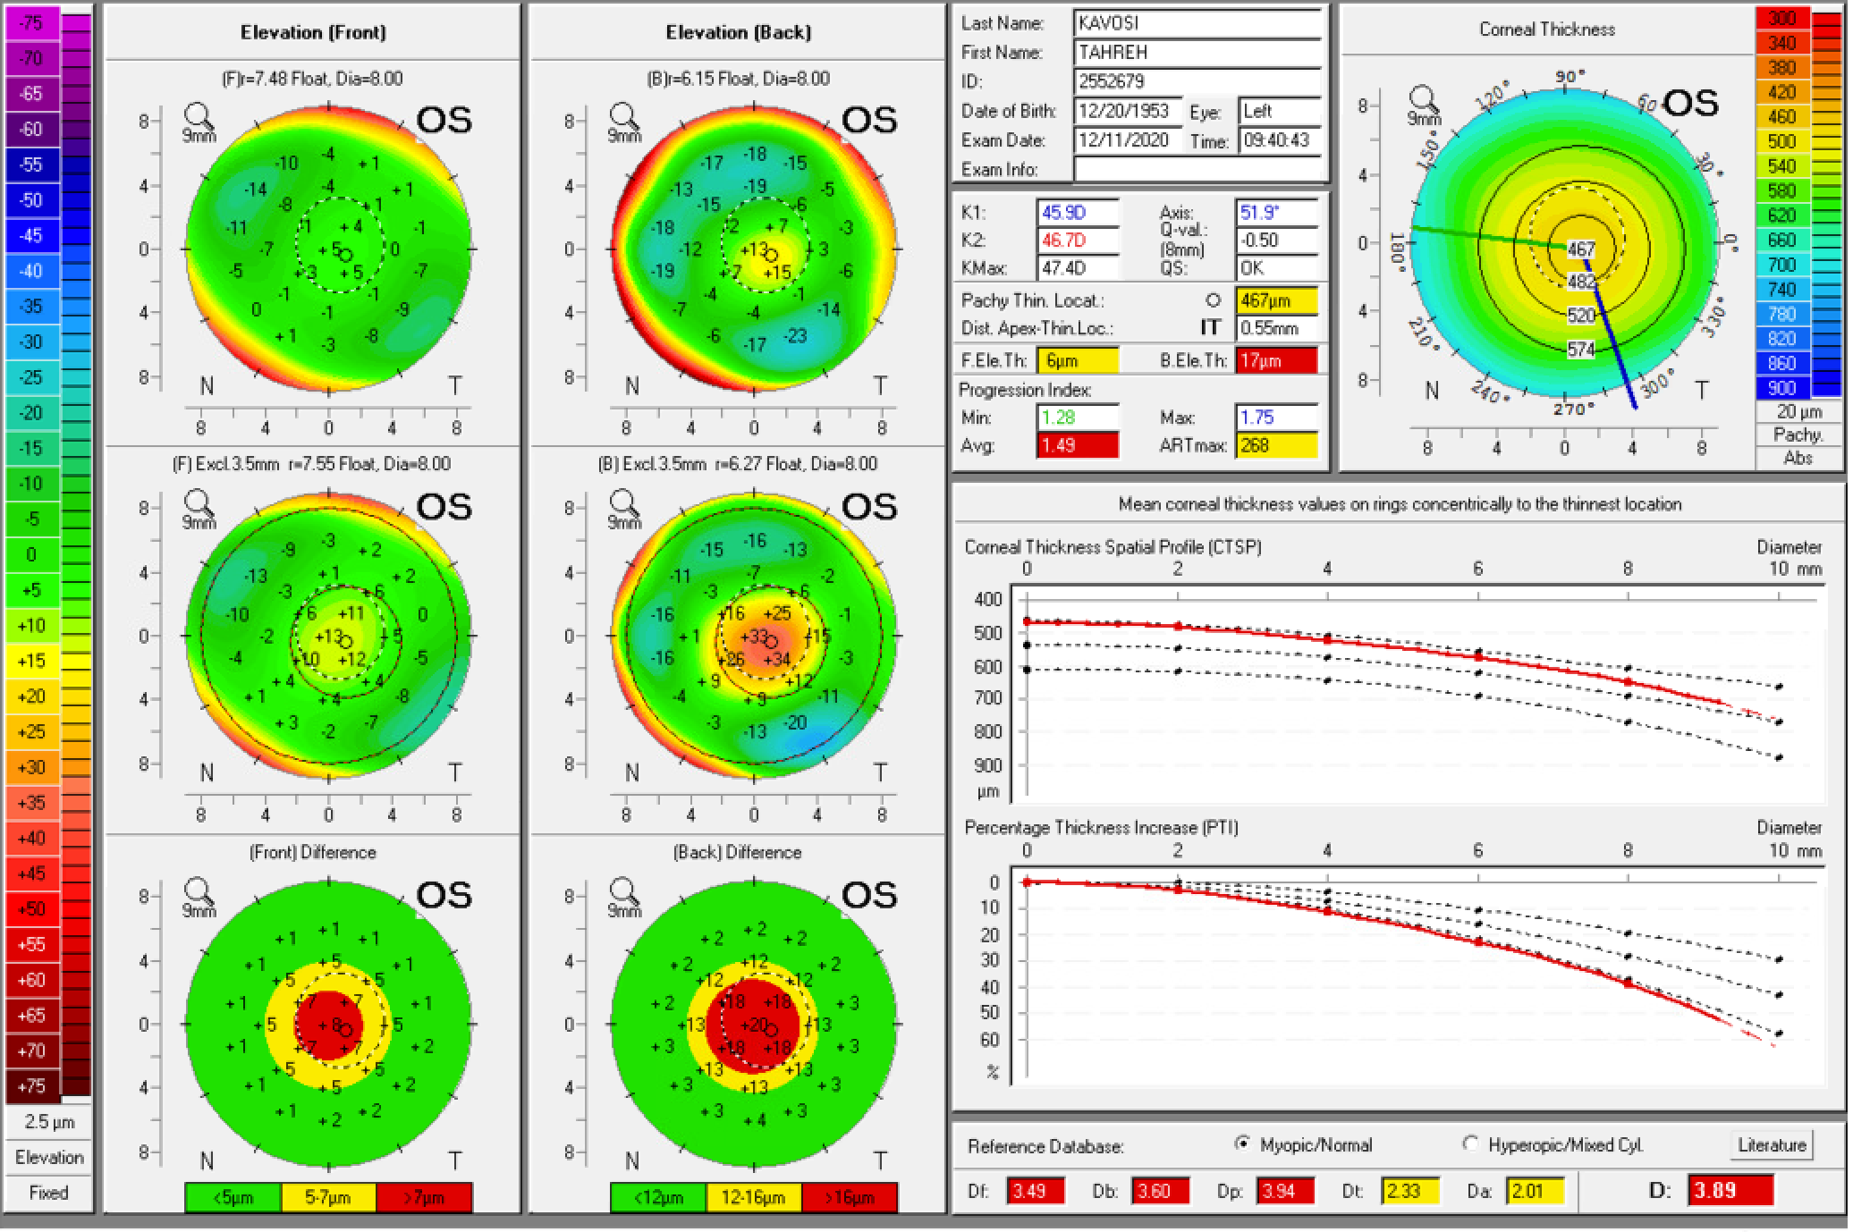

Belin Ambrosio Index
Thinnest pachy 467 um

Slide 16
Questions for the Panel
In light of the apparent forme fruste keratoconus, which lenses would you consider for this patient?
What refractive target might be appropriate?
Which formulas would you use (Holladay 2, Barrett)?
Is her goal of spectacle independence reasonable?
How would you address patient’s expectations pre-operatively?

Slide 17
Serial Measurements
  12/11/20: 1.4 D @ 21.8
  1/15/21: 1.2 D @ 27
  2/2/21: 1.2 D @ 14.3
  3/10/21: 0.9 D @ 31
IOL master: consistent ~1.2 D @177
  12/11/20: 0.8 D @ 141.9
  1/15/21: 1.0 D @ 117.2
  2/2/21: 0.8 D @ 142.0
  IOL master: consistent ~0.9 D @143

Slide 18
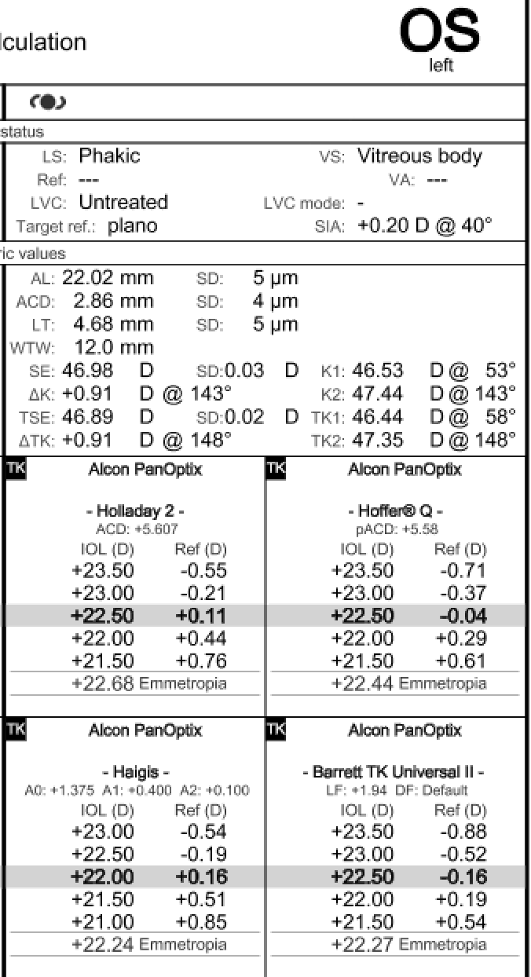
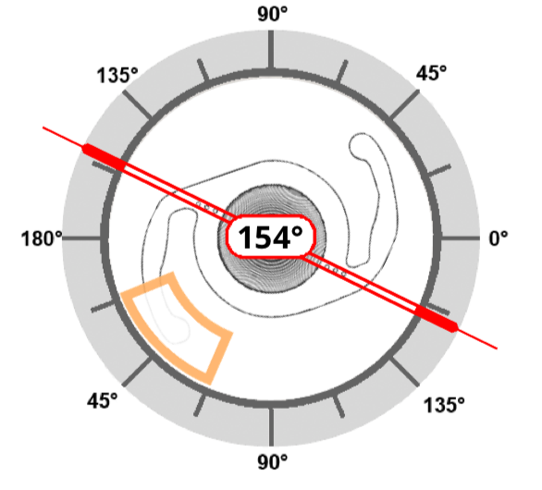
Surgical Plan
Discussed options including monofocal lens, EDOF, trifocal, and patient remained adamant about desire for good near vision after surgery
Selected a trifocal toric lens (22.5D) at 154 degrees in the LEFT eye
Uneventful surgery utilizing intraoperative aberrometry

Slide 19
POM1
 | OD | OS
Dist sc | 20/100 | 20/25
Dist PH sc | 20/40 | NI
Near sc |  | J1
MRx |  | +0.25 sph VA 20/25

Slide 20
Patient’s Response
Patient is overall very happy with her distance vision uncorrected, but still desires better near vision
However, she is right-eye dominant and feels that her (phakic) right eye “makes her near vision worse”

Slide 21
Questions for the Panel
Which lenses would you consider for the fellow eye?
Given her slightly hyperopic correction in the first eye, would you aim for a more myopic target in the fellow eye?
How long would you wait for the first eye to stabilize?
How would you approach the conversation with this patient to set expectations?

