Slide 1


Slide 2
It’s the Cataract’s fall(t)
Benyam Kinde, MD, PhD
University of California, San Francisco
Ophthalmology, PGY-3

Slide 3
Financial Disclosures
No relevant financial disclosures

Slide 4
History
56F with a history of LASIK OD x2 and OS x1 20 years ago, who is referred for slowly progressive blurry vision of her right eye
She states that her vision was significantly improved for a few years post LASIK, but has relied on contact lens for her ADLs for the last decade
Referred for progressive refractive change, concerning for progressive, post-LASIK ectasia

Slide 5
Refractive changes over time
1997
OD:
OS:
-12.50
-9.00
+2.00 x 100
+1.00 x 40
(20/20)
(20/20)
LASIK OU
“plano OU”
2000
2007
OD:
OS:
-3.25
-1.25
sph
+0.5 x 172
(20/20)
(20/20)
OD:
OS:
-10.75
-6.25
sph
+0.75 x 17
(20/30)
(20/20)
2020

Slide 6
History
POHx
  LASIK OD x2, OS x1 (2000)
  Cataracts OU
  High myope OU
  Dry eyes OU
Medications
  Lumify PRN OU
  Artificial tears
PMH
  Thyroid nodules
Allergies
  NKDA

Slide 7
Exam
VA (distance)
20/30 (-10.75 sph)
20/20 (-6.25 +0.75 X 17)
P
Round & reactive
Round & reactive
T_{a}
19
18

Slide 8
Slit Lamp Exam
OD
Normal
MGD
W&Q
LASIK flap
D&Q
R&R
2+ opalescent NS
PVD
External
L/L
C/S
K
A/C
Iris
Lens
Ant Vit
OS
Normal
MGD
W&Q
LASIK flap
D&Q
R&R
NS
PVD

Slide 9
Dilated Fundus Exam
OD
Tilted, PPA
Staphyloma
Normal
Normal
Disc
Macula
Vessels
Periphery
OS
Tilted, PPA
Flat, normal
Normal
Normal

Slide 10
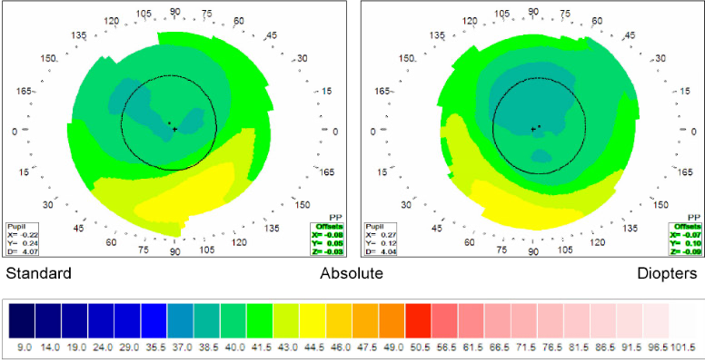
OD
K1: 40.28 @ 111
K2: 39.44 @ 21
OS
K1: 39.70 @ 34
K2: 38.88 @ 124

Slide 11
Panel discussion
What might account for our patient’s significant myopic shift?
Might a component of this be attributable to post-LASIK ectasia or gradual cataract formation?

Slide 12
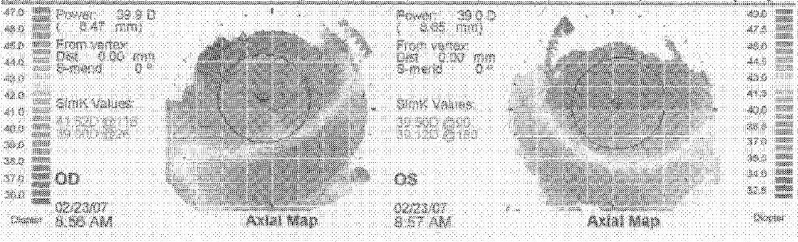
2020
2007
OD
K1: 41.52 @ 116
K2: 39.08 @ 26
OS
K1: 39.50 @ 90
K2: 38.12 @ 180
OD
K1: 40.28 @ 111
K2: 39.44 @ 21
OS
K1: 39.70 @ 34
K2: 38.88 @ 124

Slide 13
Slit Lamp Exam
OD
Normal
MGD
W&Q
LASIK flap
D&Q
R&R
2+ opalescent NS
PVD
External
L/L
C/S
K
A/C
Iris
Lens
Ant Vit
OS
Normal
MGD
W&Q
LASIK flap
D&Q
R&R
NS
PVD

Slide 14
Panel discussion
Surgical options?
Pre-operative considerations?

Slide 15
Management

Slide 16
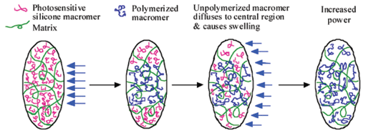
The Light-adjustable lens (LAL)
Schwartz D., Trans Am Ophthalmol Soc (2003)

Slide 17
Post-operative course
12/20
CEIOL (LAL): 12/10 (OD) and 12/17 (OS)
Treated astigmatism OU
01/05/21
OD:
OS:
-0.25
-1.25
+1.50 x 110
+0.75 x 010
(20/25)
(20/20)
Increased myopia OD, and kept OS as distant and dominant eye
01/12/21
OD:
OS:
-0.25
plano
+0.75 x 025
(20/25)
(20/20)
OD:
OS:
-1.00
plano
sph
(20/25, N_{sc} J4)
(20/20, N_{sc} J8)
Locked-in OU
01/13/21

Slide 18
Panel discussion:
Clinical Pearls

